Slide 1
React Router
Lecturer: Ngo Huy Bien
Software Engineering Department
Faculty of Information Technology
VNUHCM - University of Science
Ho Chi Minh City, Vietnam
nhbien@fit.hcmus.edu.vn

Slide 2

Objectives

Slide 3

Contents

Slide 4

References

Slide 5
SPA Navigation Requirements
When users navigate your app, they expect that:
The URL displayed in the address bar always reflects the thing that they are viewing.
They can use the browser's back and forward buttons—successfully.
They can navigate to a particular view (aka deep link) directly using the appropriate URL.
With multi-page apps, these three things come for free.
With single-page apps, to deal with all of this, you have a bucket full of techniques commonly known as routing.
Routing is where you try to map URLs to destinations that aren't physical pages, such as the individual views in your single-page app.

Slide 6
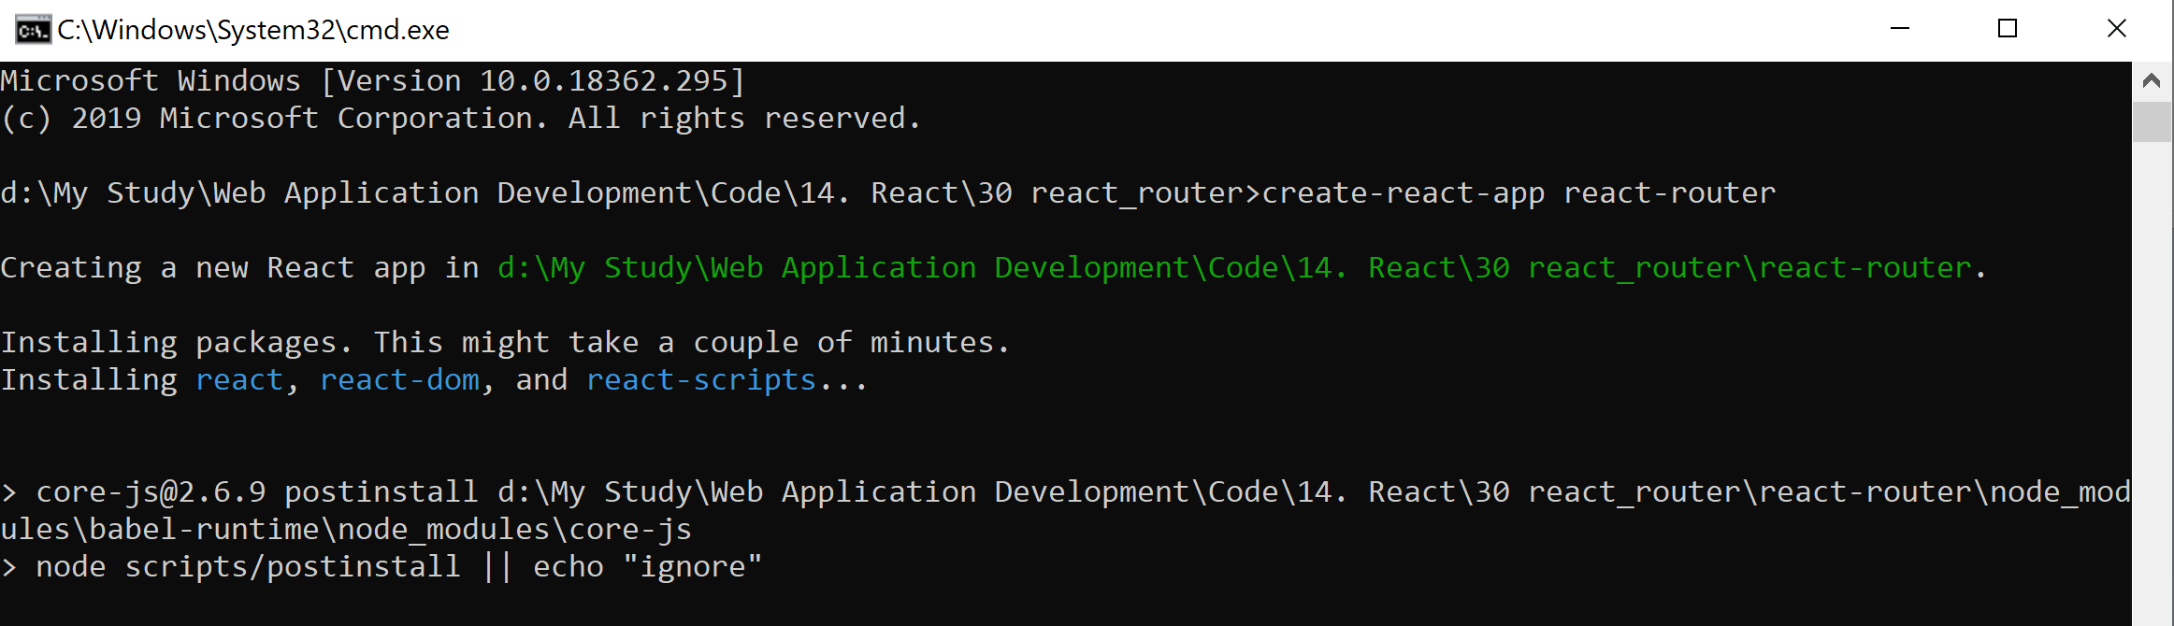
Create app
create-react-app react-router
cd react-router
npm i react-router-dom --save
npm start

Slide 7
index.html
<!DOCTYPE html>
<html>
<head>
<meta charset="utf-8">
<meta name="viewport"
content="width=device-width, initial-scale=1, shrink-to-fit=no">
<title>React Router Example</title>
</head>
<body>
<div id="root"></div>
</body>
</html>

Slide 8
Main.js
import React, { Component } from "react";
class Main extends Component {
render() {
return (
<div>
<h1>Simple SPA</h1>
<ul className="header">
<li><a href="/">Home</a></li>
<li><a href="/stuff">Stuff</a></li>
<li><a href="/contact">Contact</a></li>
</ul>
<div className="content">
</div>
</div>
);
}
}
export default Main;

Slide 9
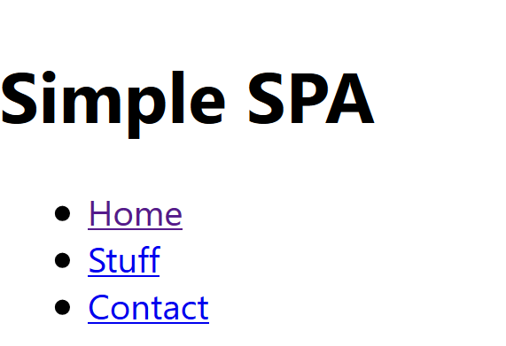
index.js
import React from 'react';
import ReactDOM from 'react-dom';
import './index.css';
import Main from './Main';
import * as serviceWorker from './serviceWorker';
ReactDOM.render(<Main />, document.getElementById('root'));
// If you want your app to work offline and load faster, you can change
// unregister() to register() below. Note this comes with some pitfalls.
// Learn more about service workers: https://bit.ly/CRA-PWA
serviceWorker.unregister();

Slide 10
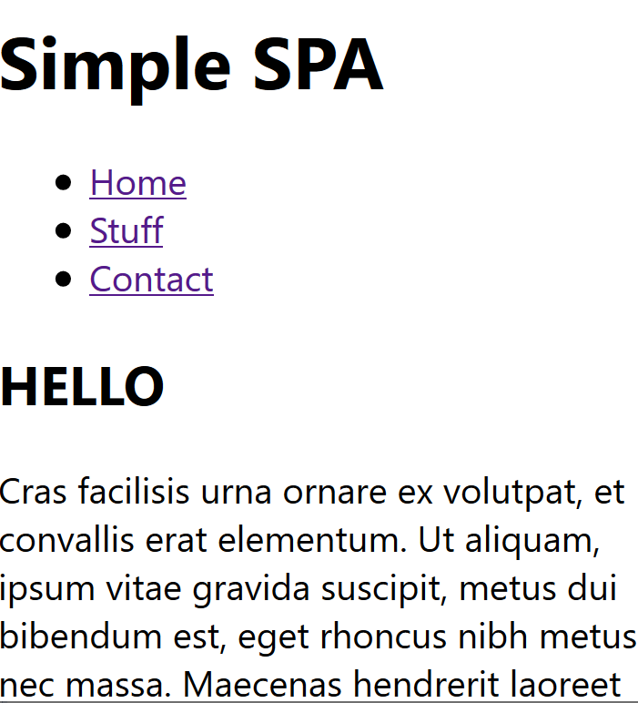
Using React Router
/* Main.js */
import React, { Component } from "react";
/* Import Route, NavLink, and HashRouter from the react-router-dom NPM package */
import {
Route,
NavLink,
HashRouter
} from "react-router-dom";
import Home from "./Home";
import Stuff from "./Stuff";
import Contact from "./Contact";
class Main extends Component {
render() {
return (
<HashRouter>
<div>
<h1>Simple SPA</h1>
<ul className="header">
<li><NavLink to="/">Home</NavLink></li>
<li><NavLink to="/stuff">Stuff</NavLink></li>
<li><NavLink to="/contact">Contact</NavLink></li>
</ul>
<div className="content">
<Route exact path="/" component={Home}/>
<Route path="/stuff" component={Stuff}/>
<Route path="/contact" component={Contact}/>
</div>
</div>
</HashRouter>
);
}
}
export default Main;

Slide 11
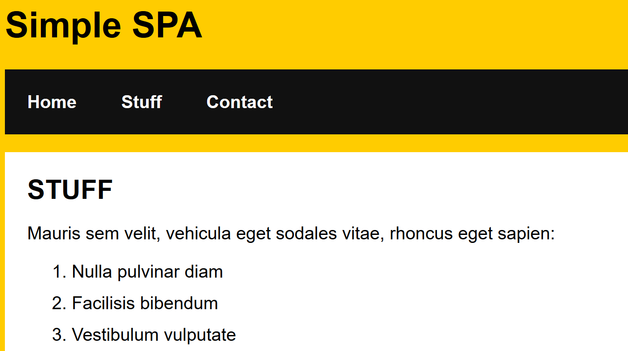
Route Matching
Route matching: For each route that matches, the component that you specified to display will appear.
When you are navigating to a page like /stuff, the App component will display because the / exists in the URL. The Stuff component then displays because the path for stuff is in the URL as well.

Slide 12
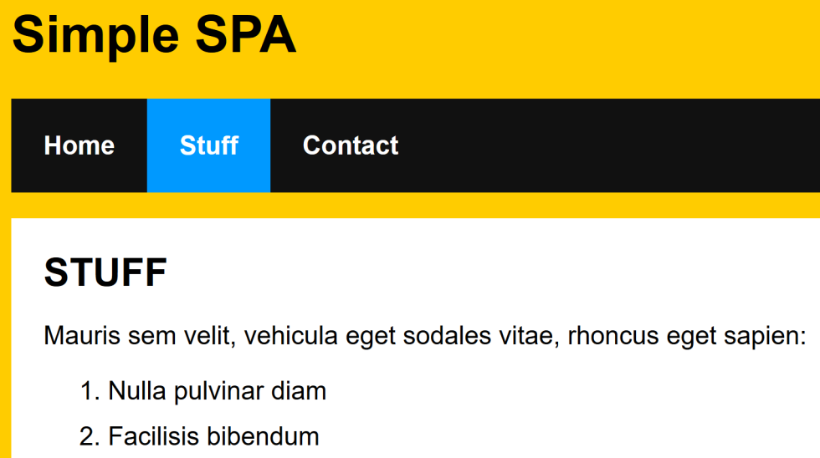
Active Link
https://reacttraining.com/react-router/web/api/NavLink

Slide 13

Thank You & See You Again

